Slide 1
Note
This presentation is for ELI Academic Track students at BCED (Business and Continuing Education Division). Students plan to enter college or university to complete an academic major.
ELI Continuing Education students who want to change their program to ELI Academic Track will also benefit.
Completion of this orientation is required for ELI Academic Track registration.

Slide 2

Welcome
We help you develop the language skills and resources to enter college directly and be successful in your academic major.

Slide 3

ELI Academic Track Guide
Academic Track program, per week: ELI 80 = 12 hours, ELI 81= 9 hours, ELI 82 = 9 hours
You must pass both ELI 82G Advanced Grammar and
ELI 82W Advanced Reading and Writing before
entering ENG 101.
A minimum 70% final grade is required to pass.
Plan to take the ACCUPLACER Math-only placement
test during your first Academic Track semester.

Slide 4

Four Keys to ELI Success
Buy your books
Come to class on time everyday
Develop working relationships with your teachers
Check Blackboard regularly

Slide 5
Keep up with your schoolwork
      Make sure you understand your
      assignments
      Have a “study buddy”
      Write down due dates and test dates
      Allow extra time to get to school
      Return from break on time

Slide 6
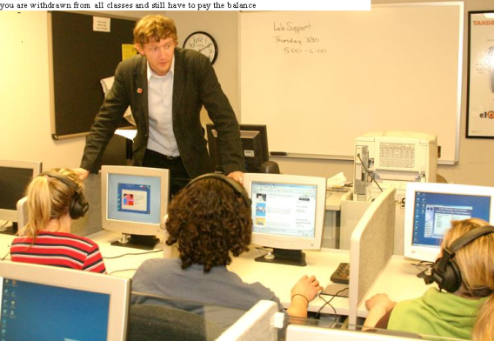
ESL Support Lab (Room 59)
Work on your grammar, reading, listening,
and vocabulary skills in the Language Lab!
Get assistance with your class assignments.
Drop by when you can- it’s not required to
come each time!
Get the ESL Support Lab schedule in Room 68.

Slide 7

Civility
At Baltimore City Community College, civility is defined as behavior that demonstrates respect for the rights, needs, and feelings of other people through behavior, attitude and words.
Send concerns about the civil behavior of BCCC faculty, staff and students to
http://www.mycompliancereport.com the access ID is “BCL”

Slide 8
BCCC Student Code of Conduct
  The Student Code of Conduct encourages all students to behave for the
  well-being of everyone in the College community.
  The ELI Student Agreement echoes the Student Code of Conduct:
    Behave in a respectful manner at all times. Listen to instructors, staff, and students and show tolerance for different ideas and viewpoints.
    Follow the instructor’s instructions and work with other students as directed.
    Participate in class activities and complete all classwork and homework assignments.

Slide 9

Plagiarism & Cheating
Plagiarism and cheating are serious offenses at U.S. colleges and universities.
Plagiarism is when a student uses sentences, phrases or ideas directly copied from the Internet or other sources in his/her own writing without giving credit to the source. It is a form of academic dishonesty.
If an instructor suspects plagiarism in a student’s paper, the student is entitled to evidence from the instructor supporting the charge.
A student charged with plagiarism has an opportunity to re-submit the paper.
BCCC Student Code of Conduct policies and
procedures will apply.

Slide 10

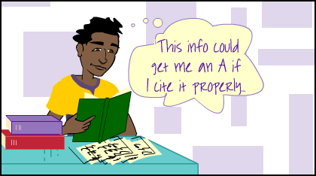
How to Avoid Plagiarism
If you use someone else’s exact words, enclose them in quotation marks. List the exact source of the quotation.
Example: As Jane Smith points out, “Xxx xxxxx xxxx xx.”
Another way is to put the author’s idea into your own words. This is called paraphrasing.
You will learn and practice giving credit to your sources using direct quotation and paraphrasing.

Slide 11
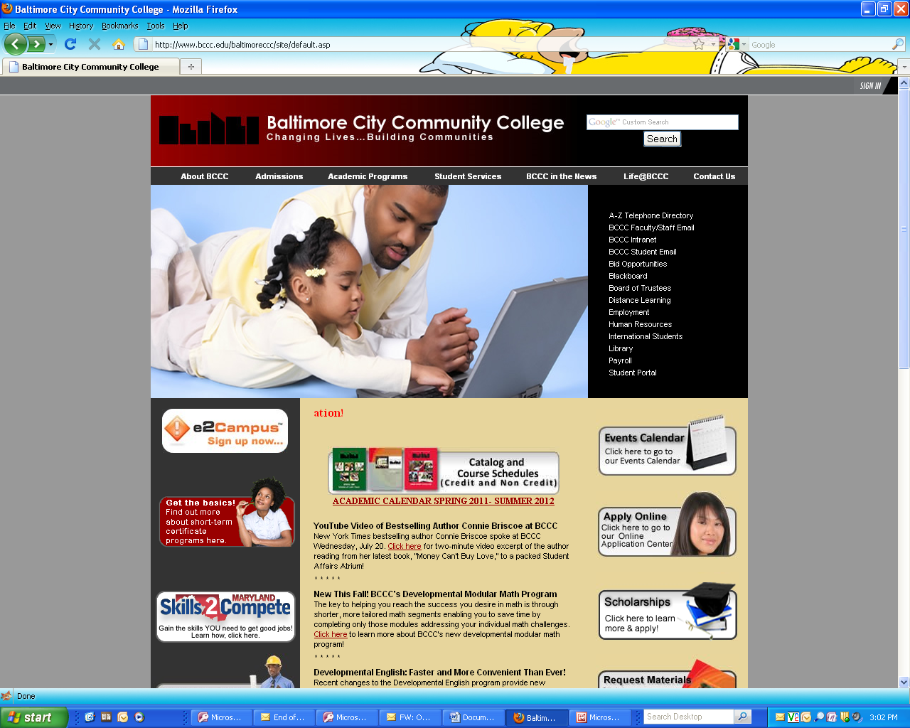
Student Portal
The Student Portal Online is where you can:
Review or update your
contact information
Read the Student Code of
Conduct
Print your schedule
Find out the status of your
Financial Aid application
Check your grades
Pay your bill
To access the Student Portal:
Go to the college website
at www.bccc.edu
Click on the Student Portal
link
Log in
To log in, you’ll need your:
000-College ID number/Social Security number and
PIN number.
(The default PIN number is your 4-digit birth month and year. For example, 0980 for September 1980. After you log in for the first time, you can change your PIN number.)

Slide 12
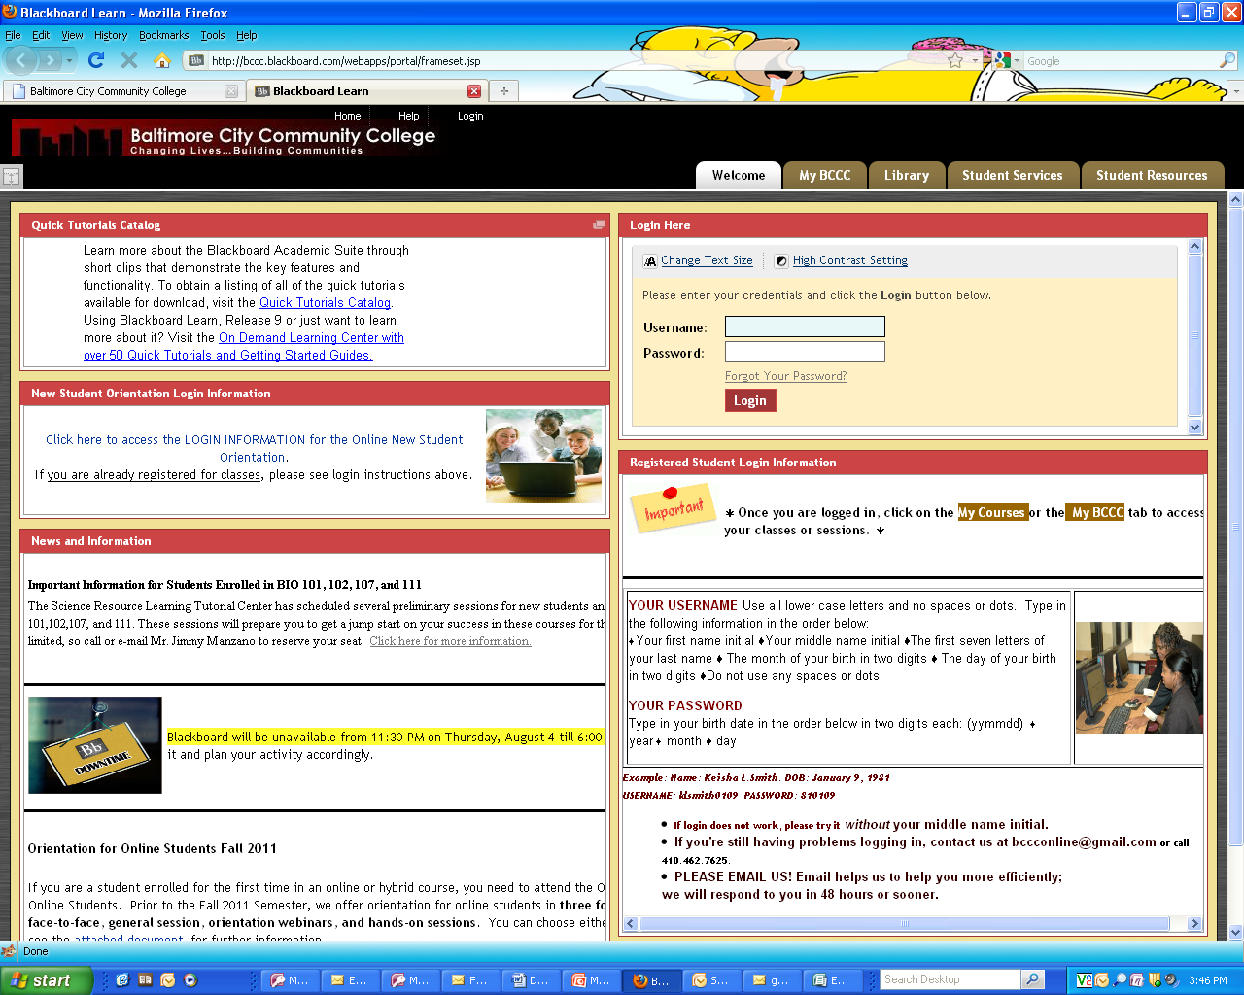
Accessing Blackboard
Blackboard is the online component of your English class. Many instructors use Blackboard to post homework assignments and provide you with additional practice activities. You can also check your grades at any time to see how you are doing in your classes. All ELI students can visit the Blackboard site by going to: http://blackboard.bccc.edu
Enter your username and password.
Username: The first letter of your first name, the first letter of your middle name, the first seven letters of your last name, and the month and day of your birthday.
For example, Jose B. Rodriguez, born on November 4, 1979, would be JBRODRIGU1104
Password: The year of birth, followed by the month and day: 791104

Slide 13

International Student Office
Visit Ms. Wanda Chaney, International Student Advisor in Rm 16 at BCED or Mr. William Hug at Liberty Campus:
to change your status to F-1 Student Visa
to request a new I-20 for study in a different program
to get advice about employment and travel
…and much more!
By appointment: Mondays and Tuesdays 9:30am- 3:30pm
Walk-in: Thursdays and Fridays 9:30am-1:30pm

Slide 14

BCCC Services @ Liberty Campus
Bard Library
  Training courses in academic skills and computer use
  Bookstore
  Textbooks, school supplies, clothing, and snacks
  Center for Academic Achievement
  Tutoring in English, Reading, and Math
  Financial Aid (FAFSA)
  Check on the status of your FAFSA award
  Test Center
  ACCUPLACER Math-only placement test
Student Accounting
Discuss tuition payment

Slide 15
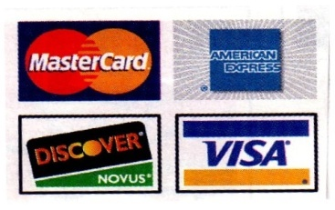
Student Accounting
Pay your tuition & fees in any of these ways:
Cash or personal check
Major credit card
Financial Aid (FAFSA)
Third Party payment

Slide 16
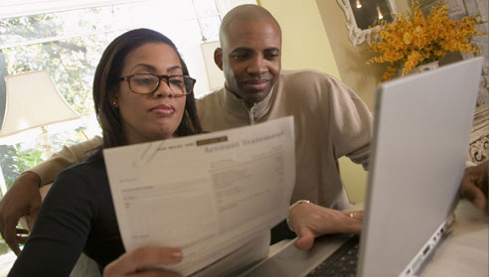
You can pay your bill electronically
Online Payment
Visit the BCCC website www.bccc.edu
Click on the Student Portal (right column)
Click on Credit Card Payment (top of left column)
You’ll need your:
1) Registration printout
2) Credit card information
BCCC accepts VISA, Master Card, Discover, and American Express.

Slide 17

Deferment Pay Agreement
A deferment agreement is a plan to pay tuition and fees in two parts throughout the semester.
Deferment contracts are signed with Student Accounting at Liberty Campus only (not at BCED).
Deferments are only possible for credit classes: ELI Academic Track, 6 credits +. They are not available to continuing education courses.
Office hours for Student Accounting: Monday-Thursday 8:00am-7:00pm, Fridays 8:00-4:00pm, Saturdays 9:00am-1:00pm. Visit Student Accounting at Liberty Campus (Main Building, Room 027) to make a Deferred Payment Plan the same day you register.

Slide 18


Deferment Payment Schedule and Conditions
Payment is in 2 installments only (50% each payment).
DEFERMENT PAY DATES
    1st Payment: When signing the Deferment Contract
    2nd Payment: May 3rd
If full payment (100%) is not made by May 3rd students will be academically withdrawn from all classes. Students will be required to pay the full balance even though they are withdrawn from their classes. Withdrawn students cannot be re-enrolled in current classes.
If you drop or add classes, or your classes are cancelled by the college after you sign the deferment contract, you must go to Student Accounting to re-calculate your contract.

Slide 19

Tuition Refund Policy
Fall and Spring Semesters
Classes Dropped: Percentage of Credit Tuition Only
  First Week of Classes 100%
  Second Week of Classes 50%
  Third Week of Classes 25%
Credit will not be given for withdrawals after the third week of class.
Some fees are non-refundable.
Winter (January term) and Summer Sessions
Classes Dropped: Percentage of Credit Tuition Only
First 2 Days of Classes 100%
  Third Day of Classes 50%
  Fourth Day of Classes 25%
Credit will not be given for withdrawals after the fourth day of class.

Slide 20

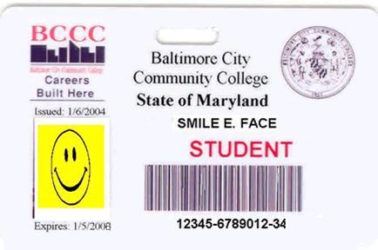
BCCC Student ID Card
You need a Student ID to use the BCCC library and to buy a discount bus pass. With your Student ID, you can sometimes get other discounts in the community.
To get a Student ID, visit Public Safety at BCED on the mezzanine (2nd floor- accessible by stairs or elevator). Show the officer your:
current registration printout
valid Maryland-approved picture identification (driver’s license or State ID)

Slide 21
BCCC Closings & Delayed Openings
If the weather is very snowy and icy, please check whether your class will meet as scheduled.
Check the College website (www.bccc.edu)
Register for E2Campus for closing notices
Watch TV news for closing information
Listen to the radio for information

Slide 22

Discounted Monthly Bus Pass
Show your current registration printout and your Student ID to the Cashier to buy a $39.00 bus pass for the month ahead. You must be taking 6 credits or more to qualify.
Spring 2013 Monthly Bus Pass Sales
February: January 28-February 6
March: February 25-March 6
April: March 26-April 4

Slide 23

Downtown BCCC Parking
Harbor Campus does not have student parking available. However, there are nearby garages that have “early bird specials”. This means that you would need to arrive before a certain time and park at a certain level to qualify for a discounted rate.
Lockwood Place Garage
Corner of Lombard Street and Market Place: across from BCCC red brick building
Arrive before 7:30 and leave by 7pm, pay $12.00.
Harbor Park Garage
Corner of Lombard Street and Market Place: above BCED
Arrive between 6 and 9am and leave by 6pm. Pay $8.00
Park on the 9th floor only (Go through 2 gates.)

Slide 24

Shuttle Bus Service
Free BCCC shuttle bus between Harbor Campus and Liberty Campus 7am—10pm, Monday—Friday.
The Harbor Campus stop is on Market Place, next to the red BCCC Building, across from Port Discovery Children’s Museum.
Leaves Harbor Campus 2 times every hour, approximately on the hour (7:00, 8:00…) and on the half-hour (7:30, 8:30…)
Leaves Liberty Campus also 2 times per hour.
Note: There are additional stops.

Slide 25
Take the long view…
Start planning your academic future with us today!

Slide 26
Your Major = Your Main Field of Study
Degree
Certificate
Associate of Arts (A.A.), Associate of Sciences (A.S.), or Associate of Applied Sciences (A.A.S.)
62-67 credits
2 years, full-time
May transfer to a
4-year institution
Academic certificate
12-37 credits
1 year, full-time
May be a “stepping-stone” to an A.A. or A.S.

Slide 27
ELI Academic Advisement
In individual advisement and group meetings with the academic advisor you’ll learn how to:
read the online BCCC course catalog
understand the curriculum of your major
understand about pre-requisites
meet BCCC faculty at College Link events
review for the ACCUPLACER Math-only test
plan your next steps!

Slide 28
Your ELI Academic Advisors
Shanta Rao, Ph.D.
ESL Student Advisor/ Rm 68
srbarry@bccc.edu
(410) 986-5462
Betsy Mackey
ELI Coordinator/ Rm 25
bmackey@bccc.edu
(410) 986-5433

Slide 29
Best wishes studying at BCCC!

